Slide 1
Smart irrigation system

Slide 2
Team
We are a team of four member currently perusing our B.E at Thapar University.
Nishkarsh Jain(TEAM LEADER)
Apoorve Gupta
Harpuneet Singh
Shreya N. Bhojake
Working under the guidance of Dr. K.S. Sandha
Dr. Shireesh K. Rai

Slide 3
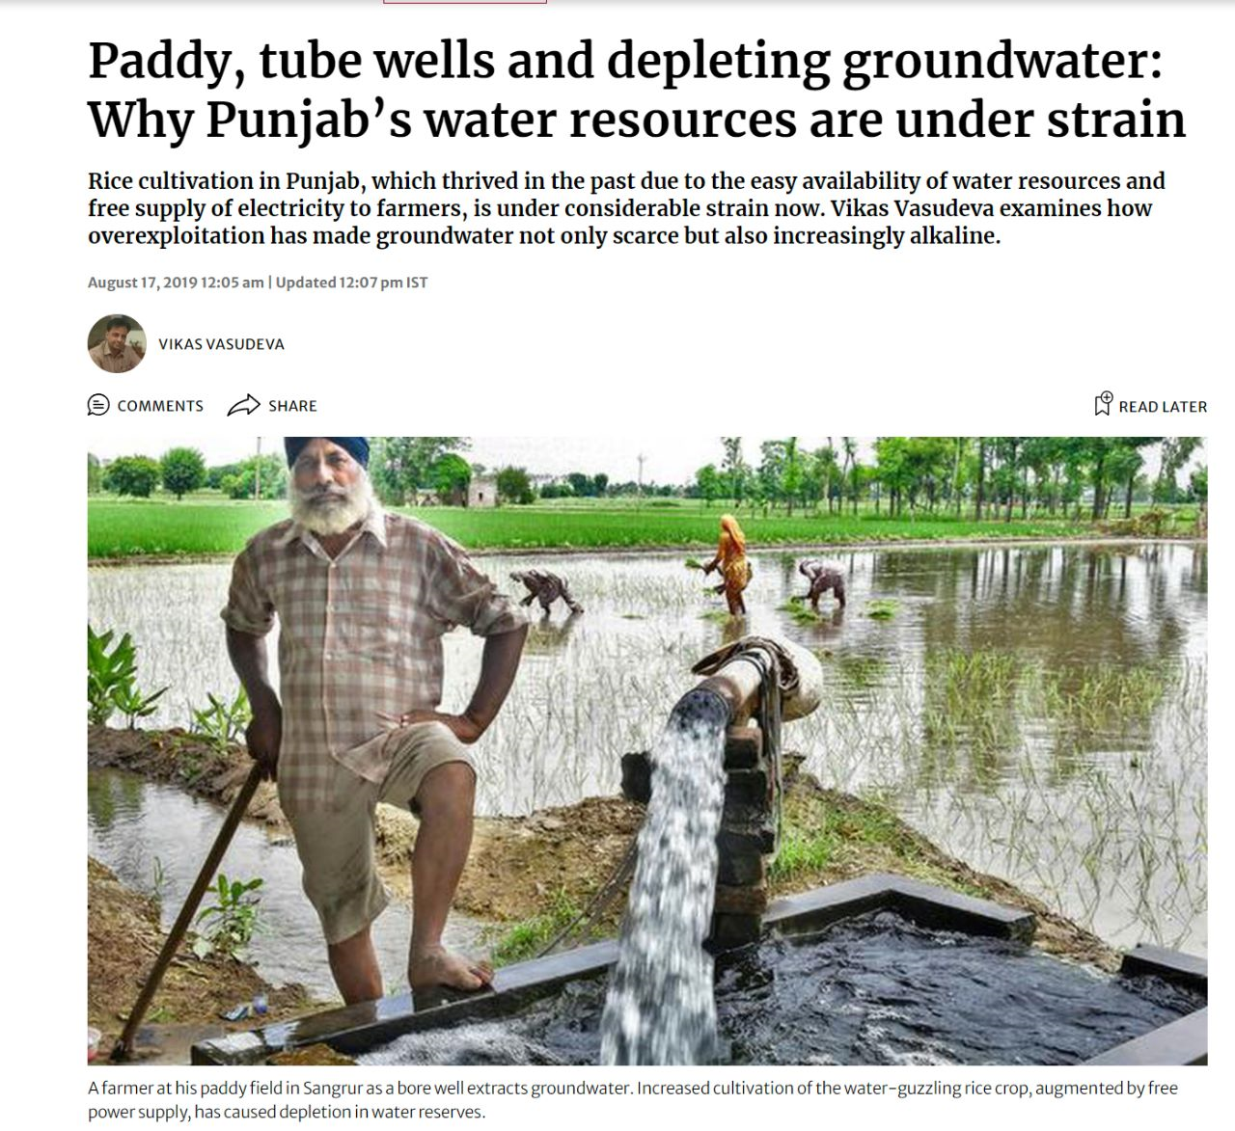
objective
Punjab is expected to run short of ground water within the next 17 years, the state has provided farmers with free electricity to pump out ground water which is resulting in
declining water level
Overflooding of fields
High power consumption
Our project aims to combat this issue and find a sustainable and affordable solution.
Irrigation is majorly, 72% through tube-wells (mostly electricity driven), 28% through canals
Pic: Article about the depleting ground water levels of Punjab published by The Hindu.

Slide 4
PROBLEM
Depleting ground water levels
Punjab would be left with groundwater for 17 years, till 2039.
Average groundwater depth has crossed 70 meters (200 feet), with central and southern parts crossing 150 meters (450 feet)
High power consumption
Punjab’s policy of providing free electricity to farmers, since 1997
subsidy of Rs. 6060.27 crores in year 2019-2020
overflooding
Poor quality and quantity yield
Manual dependence
Water level measurement and pump water diversion is still highly labor dependent

Slide 5
SOLUTION
Ground Water Levels
Power Consumption
Notifications will be sent when pumps should be operated which an be controlled remotely
Continuous supervision and remote access will enable to divert or turn off the pumps when not required.
Efficient Irrigation
Automation
Continuous supervision will prevent farms from flooding
Sensors will eliminate scope of human error and improve efficiency

Slide 6
THANK YOU

